Slide 1



MATRUSRI ENGINEERING COLLEGE DEPARTMENT OF COMPUTER SCIENCE AND ENGINEERING
MATRUSRI
ENGINEERING COLLEGE
Fake Product Identification through QR-CODE Using Blockchain Technology
Under the guidance of B.J.Praveena
(Assistant Professor)
BATCH NO:A-18
1608-18-733-025 – Neeraj Ganji
1608-18-733-029 – P.Anurag Sharma
1608-18-733-036 – Pranav Vuppala

Slide 2
MATRUSRI
ENGINEERING COLLEGE
ABSTRACT
In recent years, Counterfeit products play an important role in product manufacturing industries. This affects the companies name, sales, and profit of the companies. Blockchain technology is used to identification of real products and detects fake products.
Blockchain technology is the distributed, decentralized, and digital ledger that stores transactional information in the form of blocks in many databases which is connected with the chains. Blockchain technology is secure technology therefore any block cannot be changed or hacked. By using Blockchain technology, customers or users do not need to rely on third-party users for confirmation of product safety.

Slide 3
MATRUSRI
ENGINEERING COLLEGE
INTRODUCTION
Fake products have a significant detrimental influence on the market for both consumers and sellers.
The sellers fail to provide the goods as per the buyers' expectations, and the consumers begin to suspect the company's quality and standards, resulting in poor marketing of the brand whose counterfeit items are being distributed in the market.
The most dangerous aspect of counterfeit items is that they may be extremely detrimental to users. Because fake or counterfeit items are not limited to any single area of the market, it is critical that we recognise these products and find a strategy to keep them out of the market.
When we examine dominating sectors like pharmaceuticals and food supplies, these items may be quite risky. To address such issues, we must retain data that is freely available to customers, allowing them to check product details and establish a level of trust in the product's legitimacy.

Slide 4
MATRUSRI
ENGINEERING COLLEGE
LITERATURE SURVEY
[1] AI Based Fake Product Detection System The paper entitled ‘IMPROVING FAKE PRODUCT DETECTION USING AI- BASED TECHNOLOGY’ describes how an ai based system can be used to reduce fake products where we do not require any special device to verify the authenticity of the product. Machine learning uses the data set and training data provided it to generate the outcome whether the product is genuine or not. It analyses the logos or the information captured by the end user through their device and verifies it with the data available. After detection the server returns the result to end user to make further decision.
[2] RFID Anti-Counterfeiting The paper entitled ‘RFID Anti-Counterfeiting for Retailing Systems’ describes how we can use RFID counterfeit system. In this system the author proposes a system consisting of two protocols. The first one is tag authentication protocol which allows users to authenticate the product without revealing their important information and the other one is data correction protocol which ensures the correctness of the tag status.
[3] Image Watermarking QR code System The paper entitled ‘Research on Anti-counterfeiting Technology Based on QR Code image Watermarking Algorithm’ explains how we can embed the carrier image to the QR code to enable image watermarking in QR code. It is a more robust DWT and SVD based watermarking algorithm. n. The experiment proved that this method can resist compressive attack, rotation attack, noise attack and so on.

Slide 5
MATRUSRI
ENGINEERING COLLEGE
LITERATURE SURVEY
[4] A Survey of Counterfeit Product Detection by Prabhu Shankar, R. Jayavadivel. Counterfeit products are growing exponentially with the enormous amount of online and black-market. This paper discusses various techniques for identifying counterfeit products.
[5] A Blockchain-based Supply Chain Quality Management Framework by Si Chen, Rui Shi. In this paper, they proposed a blockchain-based framework. This framework will provide a theoretical basis for intelligent quality management of the supply chain based on blockchain technology. Blockchain ideas by geeks for geeks, In this paper they proposed a system for identifying fake products using blockchain through barcode.

Slide 6
MATRUSRI
ENGINEERING COLLEGE
SYSTEM ANALYSIS
EXISTING SYSTEM:
The existing system detects fake products using database /cloud as a web application without using blockchain.
System tracks the product from Manufacturing phase to delivery phase.
But , as database is mutable and is not decentralized it can be modified by admin of the database.
Information tampering can be possible if we use database which is not safe when it comes to storing information which should not be tampered.
LIMITATIONS OF EXISTING SYSTEM:
Information can be tampered easily .
Centralized access to the system, users will not have access to all the functionalities.
Database is mutable and is not decentralized it can be modified by admin of the database.

Slide 7
MATRUSRI
ENGINEERING COLLEGE
SYSTEM ANALYSIS
PROPOSED SYSTEM:
The proposed system detects fake products using blockchain technology as an android application for the detection of counterfeit products.
In the proposed framework, the framework produces QR codes utilizing Blockchain innovation.
QR code of the product is linked to a Blockchain. So this system may be used to store product details and generate unique code.
It collects the unique code from the user and compares the code against entries in the Blockchain database.
If code doesn’t match then it will give notification stating it is a fake product.

Slide 8
MATRUSRI
ENGINEERING COLLEGE
SYSTEM ANALYSIS
PROPOSED METHODOLOGY:
This project is primarily separated into two modules: 1) Manufacturer and 2)Consumer/user. After logging in, the manufacturer will input product data such as product id, name, and company name . The information entered by the manufacturer is saved in blocks. The SHA-256 algorithm is used to generate the hash code when this information is included. This hash code is used to generate a QR-code, which is printed on the merchandise. The user will receive this QR-code after purchasing the product, which he may scan with a web camera or a QR-code scanner that was previously imported.
If the hash code within the blockchain and the hash code generated after scanning are the same, the product is considered to be original, and the consumer will be presented product data otherwise, it detects that the product is counterfeit.

Slide 9
MATRUSRI
ENGINEERING COLLEGE
SYSTEM ANALYSIS
PROCESS LOGIC FOR BLOCKCHAIN IMPLEMENTATION:
The information will be saved in the JSON format, which is characterised by its simplicity both in terms of its implementation and its readability. A block is used to store the data, and inside that block are numerous copies of the data. Each and every minute, many blocks are added, and in order to tell one from the other, we will be using fingerprinting to distinguish between them.
This process is carried out by means of hash, and the SHA256 hashing method will be used in particular for this purpose. Every block will have its own unique hash, as well as the hash of the function that came before it, making it impossible for the data to be manipulated.
Current block hash will be previous hash for the next block and so on this way blocks are connected to form a chain.
Proof of work method is included which makes it way more difficult to perform operations to create a new block and add it to the chain. This indicates that anybody who edits a prior block will need to repeat the work associated with that block as well as the work associated with all of the blocks that follow it. We can restrict it furthermore by increasing difficulty associated with creating blocks.

Slide 10
MATRUSRI
ENGINEERING COLLEGE
TECHNOLOGY STACK
Hardware Requirements
• System: MINIMUM i3.
• Hard Disk: 40 GB.
• Ram: 4 GB.
Software Requirements
• Operating System: Windows 8
• Coding Language: Python 3.7
Software Tools Used
● GUI Applications (Tkinter)
● Image processing (Opencv,pillow)
● XAMPP Local server
● MySQL database

Slide 11
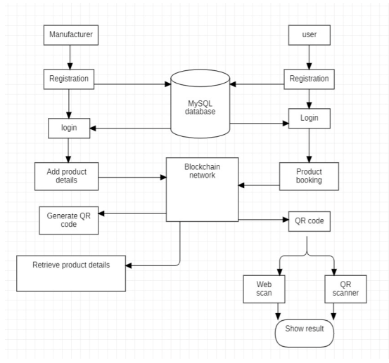
MATRUSRI
ENGINEERING COLLEGE
SYSTEM DESIGN
SYSTEM ARCHITECTURE:
D

Slide 12
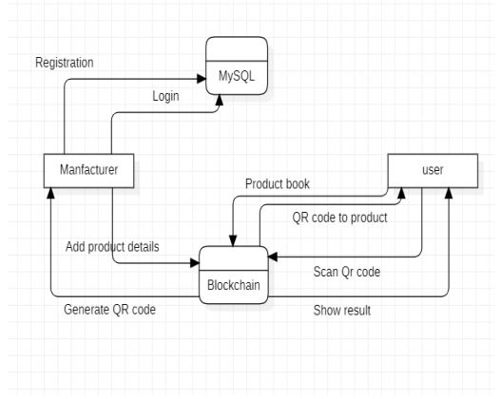
MATRUSRI
ENGINEERING COLLEGE
SYSTEM DESIGN
DATA FLOW DIAGRAM:

Slide 13
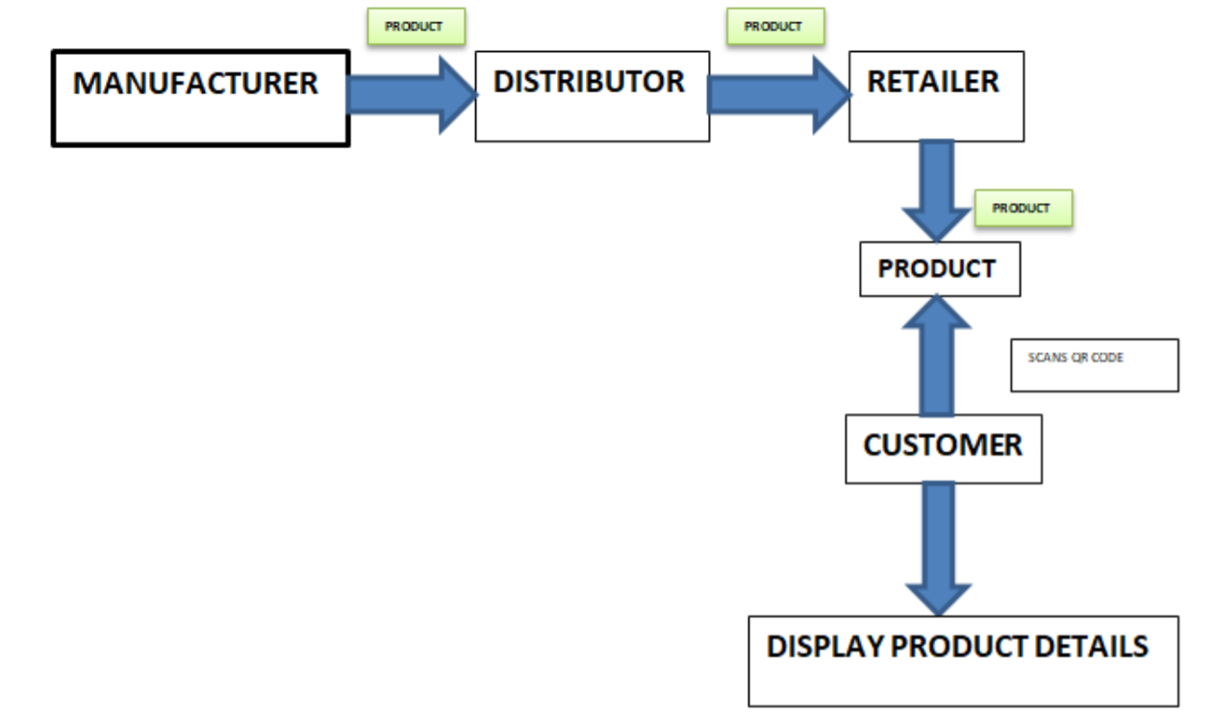
MATRUSRI
ENGINEERING COLLEGE
SYSTEM DESIGN
FLOW CHART:
X

Slide 14
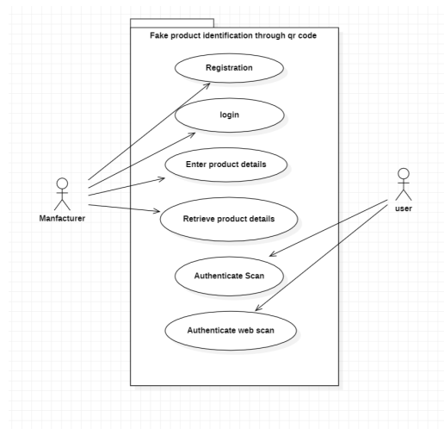
MATRUSRI
ENGINEERING COLLEGE
SYSTEM DESIGN
USE CASE DIAGRAM:

Slide 15
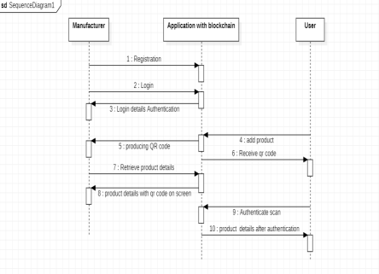
MATRUSRI
ENGINEERING COLLEGE
SYSTEM DESIGN
SEQUENCE DIAGRAMS:

Slide 16
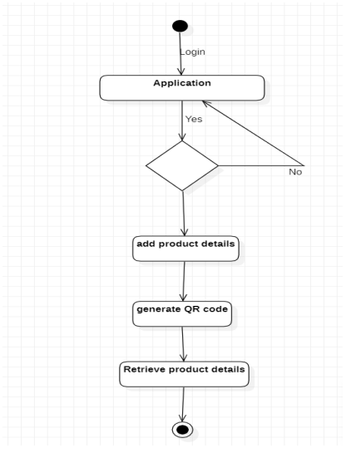
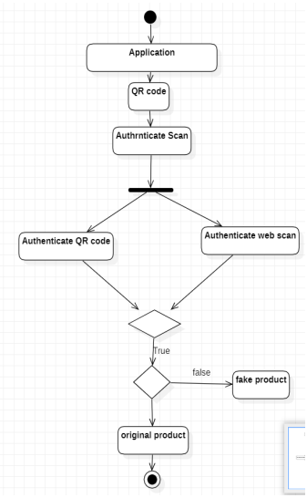
MATRUSRI
ENGINEERING COLLEGE
SYSTEM DESIGN
ACTIVITY DIAGRAMS:
MANUFATURER SIDE: USER SIDE:

Slide 17
MATRUSRI
ENGINEERING COLLEGE
SOURCE CODE
from tkinter import messagebox
from tkinter import *
from tkinter import simpledialog
import tkinter
from tkinter import filedialog
from tkinter.filedialog import askopenfilename
from Block import *
from Blockchain import *
from hashlib import sha256
import os
import datetime
import webbrowser
import qrcode
import random
import cv2
import sys
from PIL import ImageTk, Image
import PIL.Image
import imageio
import threading

Slide 18
MATRUSRI
ENGINEERING COLLEGE
SOURCE CODE
main = tkinter.Tk()
main.title("Fake Prodduct Identificaion With QR-Code Using BloackChain")
main.attributes('-fullscreen', True)
#main.geometry('1300x1200')
video_name = "bg\\home.mp4" #This is your video file path
video = imageio.get_reader(video_name)
def stream(label):
for image in video.iter_data():
frame_image = ImageTk.PhotoImage(PIL.Image.fromarray(image))
label.config(image=frame_image)
label.image = frame_image
my_label = tkinter.Label(main)
my_label.pack()
thread = threading.Thread(target=stream, args=(my_label,))
thread.daemon = 1
thread.start()
global filename
blockchain = Blockchain()
if os.path.exists('blockchain_contract.txt'):
with open('blockchain_contract.txt', 'rb') as fileinput:
blockchain = pickle.load(fileinput)
fileinput.close()

Slide 19
MATRUSRI
ENGINEERING COLLEGE
SOURCE CODE
def addProduct():
global filename
text.delete('1.0', END)
#filename = askopenfilename(initialdir = "original_barcodes")
#with open(filename,"rb") as f:
# bytes = f.read()
#f.close()
pid = tf1.get()
name = tf2.get()
user = tf3.get()
address = tf4.get()
neeraj=hex(random.getrandbits(128))
bytes=neeraj.encode('utf-8')
digital_signature = sha256(bytes).hexdigest();
global QRimg
logo = Image.open('bg\\logo.jpg')
basewidth = 100
wpercent = (basewidth/float(logo.size[0]))
hsize = int((float(logo.size[1])*float(wpercent)))
logo = logo.resize((basewidth, hsize), Image.ANTIALIAS)
QRcode = qrcode.QRCode(error_correction=qrcode.constants.ERROR_CORRECT_H)
QRcode.add_data(digital_signature)
QRcode.make(fit=True)
QRimg = QRcode.make_image().convert('RGB')
pos = ((QRimg.size[0] - logo.size[0]) // 2, (QRimg.size[1] - logo.size[1]) // 2)
QRimg.paste(logo, pos)
QRimg.save('original_barcodes'+'\\'+str(pid)+'productQR.png')

Slide 20
MATRUSRI
ENGINEERING COLLEGE
SOURCE CODE
if len(pid) > 0 and len(name) > 0 and len(user) > 0 and len(address) > 0:
current_time = datetime.datetime.now()
data = pid+"#"+name+"#"+user+"#"+address+"#"+str(current_time)+"#"+digital_signature
blockchain.add_new_transaction(data)
hash = blockchain.mine()
b = blockchain.chain[len(blockchain.chain)-1]
text.insert(END,"Blockchain Previous Hash : "+str(b.previous_hash)+"\n")
text.insert(END,"Block No : "+str(b.index)+"\n")
text.insert(END,"Current Hash : "+str(b.hash)+"\n")
text.insert(END,"Product Qr-code no : "+str(digital_signature)+"\n")
blockchain.save_object(blockchain,'blockchain_contract.txt')
img2= Image.open('original_barcodes'+'\\'+str(pid)+'productQR.png')
load=img2.resize((200,200))
render = ImageTk.PhotoImage(load)
img = Label(main, image=render)
img.place(x=140, y=500)
tf1.delete(0, 'end')
tf2.delete(0, 'end')
tf3.delete(0, 'end')
tf4.delete(0, 'end')
messagebox.showinfo("QR Code Generator", "QR Code is saved successfully!")

Slide 21
MATRUSRI
ENGINEERING COLLEGE
SOURCE CODE
else:
text.insert(END,"Please enter all details")
def searchProduct():
text.delete('1.0', END)
pid = tf1.get()
flag = True
if len(pid) > 0:
for i in range(len(blockchain.chain)):
if i > 0:
b = blockchain.chain[i]
data = b.transactions[0]
arr = data.split("#")
if arr[0] == pid:
global QRimg
logo = Image.open('bg\\logo.jpg')
basewidth = 100
wpercent = (basewidth/float(logo.size[0]))

Slide 22
MATRUSRI
ENGINEERING COLLEGE
SOURCE CODE
arr = data.split("#")
if arr[0] == pid:
global QRimg
logo = Image.open('bg\\logo.jpg')
basewidth = 100
wpercent = (basewidth/float(logo.size[0]))
hsize = int((float(logo.size[1])*float(wpercent)))
logo = logo.resize((basewidth, hsize), Image.ANTIALIAS)
#logo = logo.resize((basewidth, hsize), Image.Resampling.LANCZOS)
QRcode = qrcode.QRCode(error_correction=qrcode.constants.ERROR_CORRECT_H)
QRcode.add_data(arr[5])
QRcode.make(fit=True)
QRimg = QRcode.make_image().convert('RGB')
pos = ((QRimg.size[0] - logo.size[0]) // 2, (QRimg.size[1] - logo.size[1]) // 2)
QRimg.paste(logo, pos)
QRimg.save('original_barcodes'+'\\'+str(pid)+'productQR.png')
output = ''
text.insert(END,"Product Details extracted from Blockchain using Product ID : "+pid+"\n\n")
text.insert(END,"Product ID : "+arr[0]+"\n")
text.insert(END,"Product Name : "+arr[1]+"\n")
text.insert(END,"Company/User Details : "+arr[2]+"\n")
text.insert(END,"Address Details : "+arr[3]+"\n")
text.insert(END,"Scan Date & Time : "+arr[4]+"\n")

Slide 23
MATRUSRI
ENGINEERING COLLEGE
SOURCE CODE
output='<html><body><table border=1>'
output += '<tr><th>Block No</th><th>Product ID</th><th>Product Name</th><th>Company/User Details</th><th>Address Details</th><th>Scan Date & Time</th><th>Product Qr code</th></tr>'
output += '<tr><td>' + str(i) + '</td><td>' + arr[0] + '</td><td>' + arr[1] + '</td><td>' + arr[2] + '</td><td>' + arr[3] + '</td><td>' + arr[4] + '</td><td>' + arr[5] + '</td></tr>'
f = open("output.html", "w")
f.write(output)
f.close()
#webbrowser.open("output.html",new=1)
flag = False
img2= Image.open('original_barcodes'+'\\'+str(pid)+'productQR.png')
load=img2.resize((200,200))
render = ImageTk.PhotoImage(load)
img = Label(main, image=render)
img.place(x=140, y=500)
#messagebox.showinfo("", "Retrieve product QR-code!")
break
if flag:
text.insert(END,"Given product id does not exists")

Slide 24
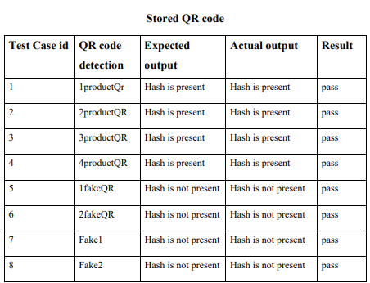
MATRUSRI
ENGINEERING COLLEGE
SOFTWARE TESTING

Slide 25
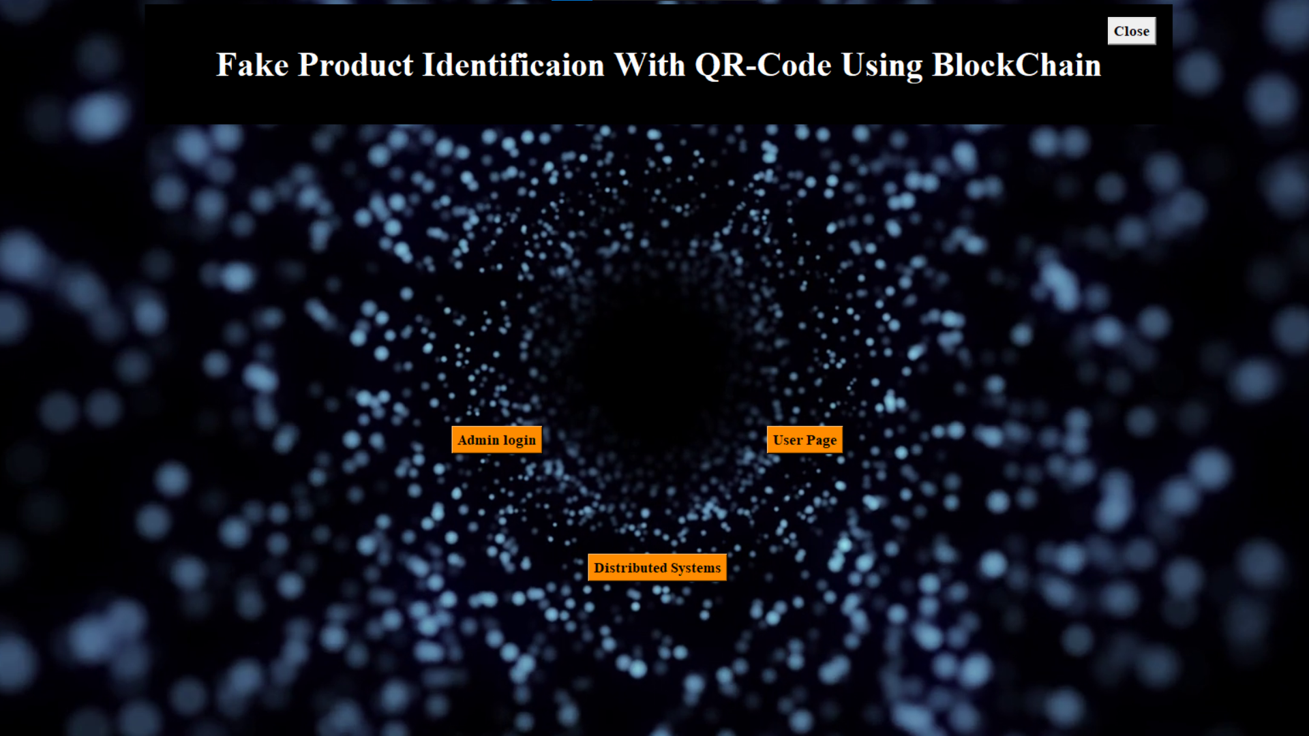
MATRUSRI
ENGINEERING COLLEGE
OUTPUT SCREEN

Slide 26
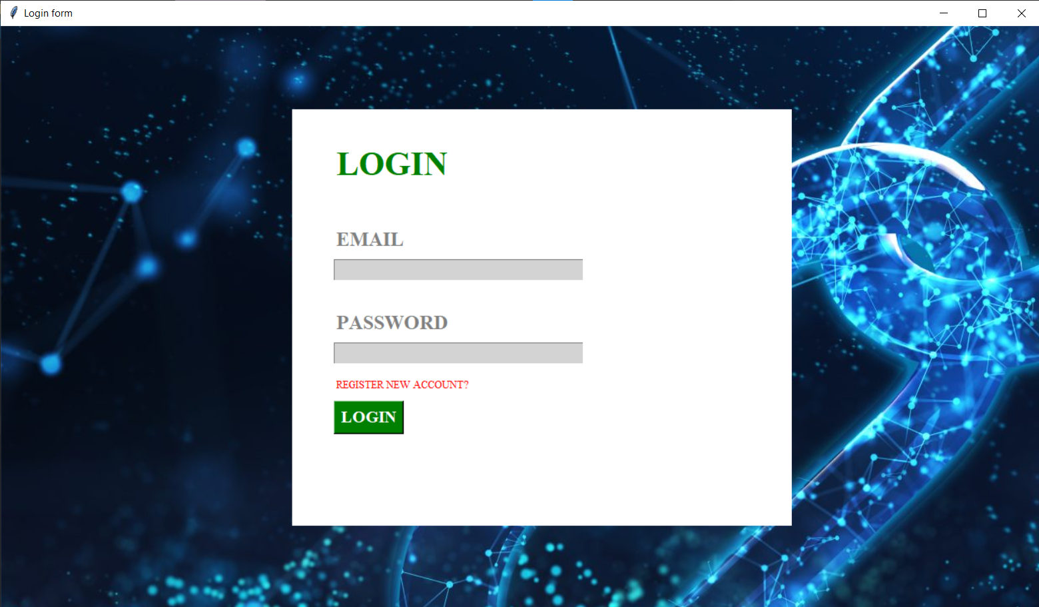
MATRUSRI
ENGINEERING COLLEGE
OUTPUT SCREEN

Slide 27
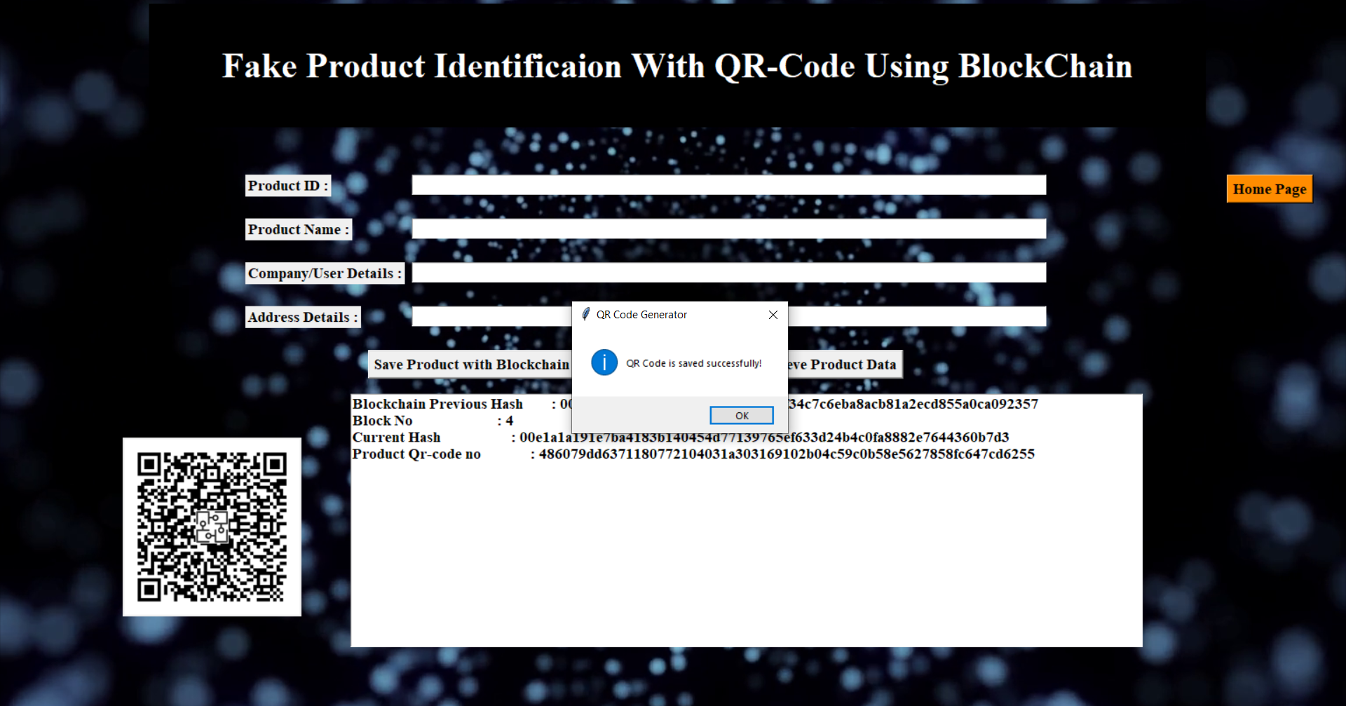
MATRUSRI
ENGINEERING COLLEGE
OUTPUT SCREEN

Slide 28
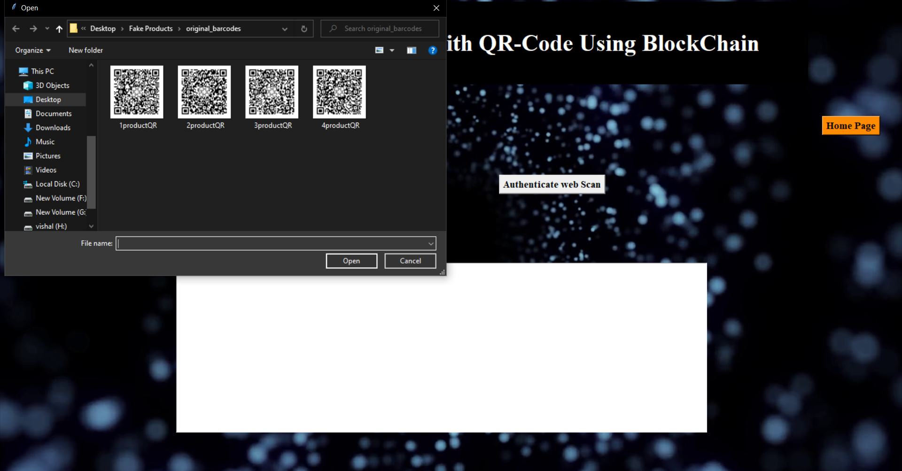
MATRUSRI
ENGINEERING COLLEGE
OUTPUT SCREEN

Slide 29
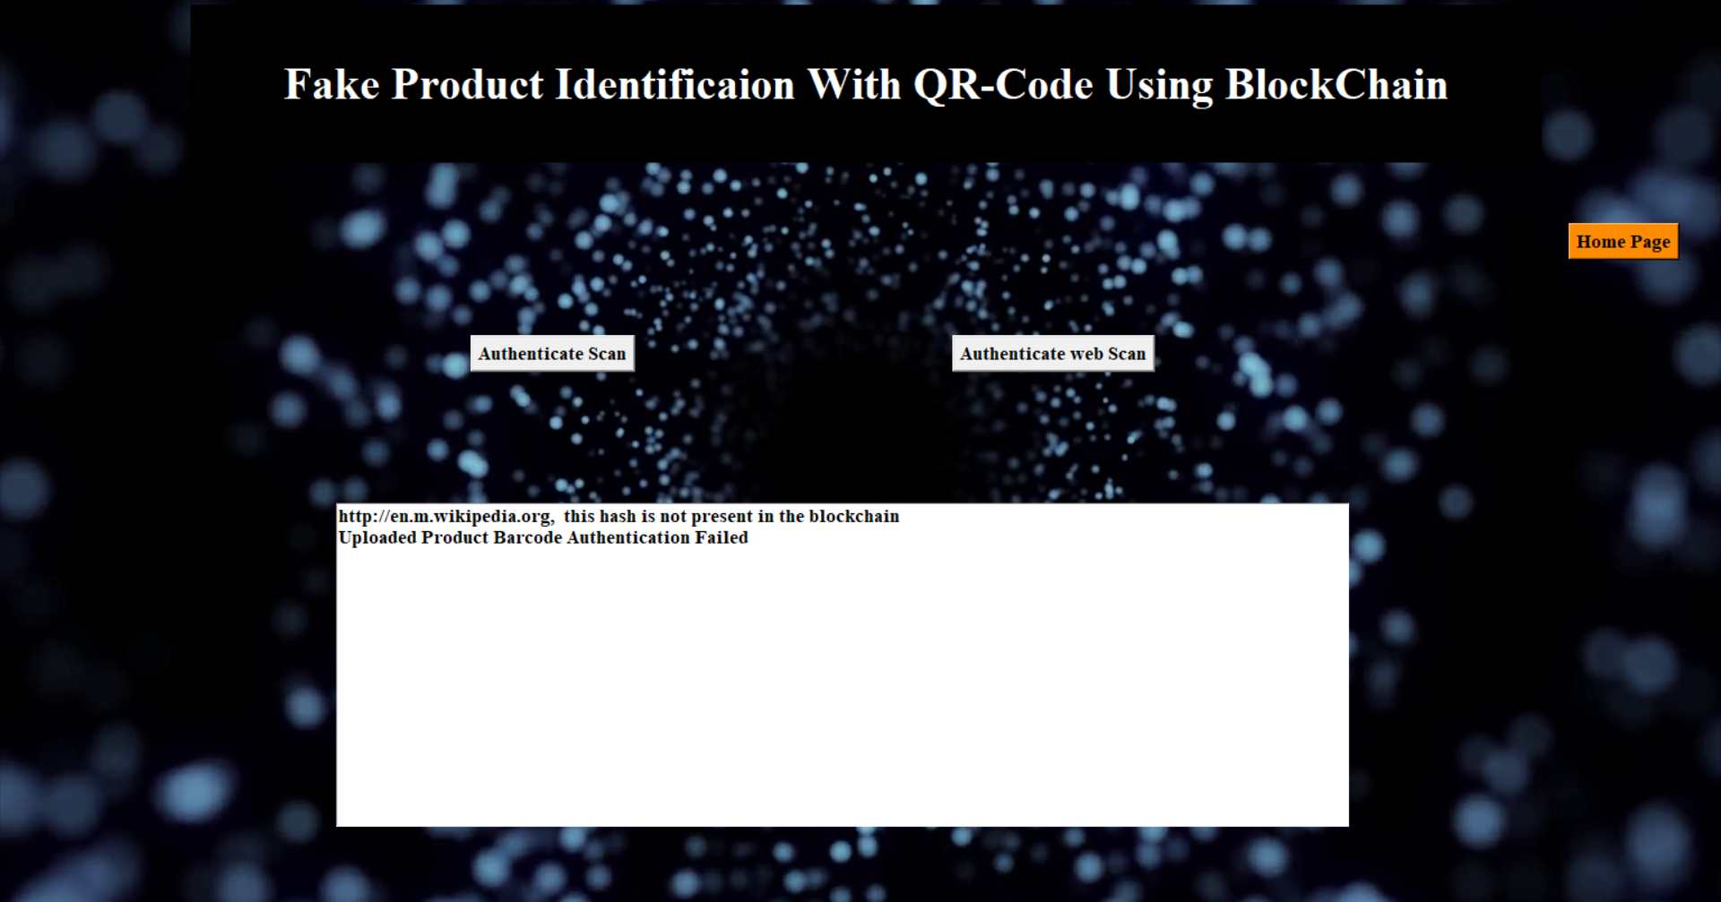
MATRUSRI
ENGINEERING COLLEGE
OUTPUT SCREEN

Slide 30
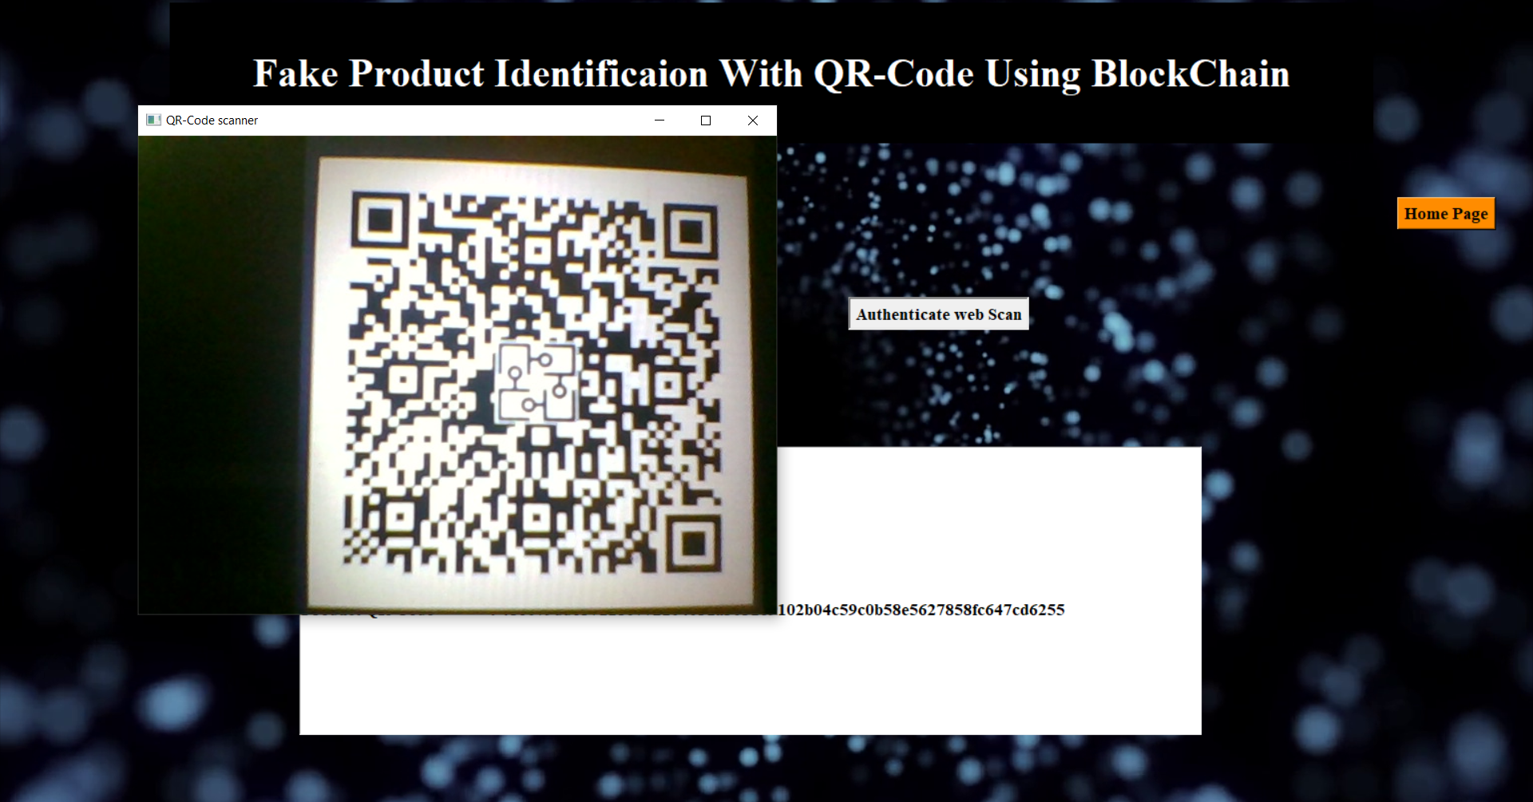
MATRUSRI
ENGINEERING COLLEGE
OUTPUT SCREEN

Slide 31
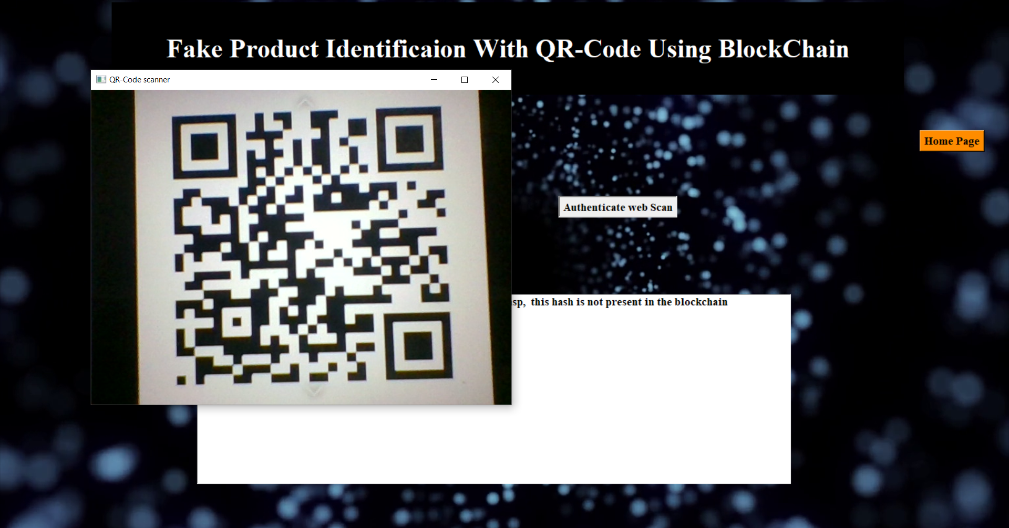
MATRUSRI
ENGINEERING COLLEGE
OUTPUT SCREEN

Slide 32
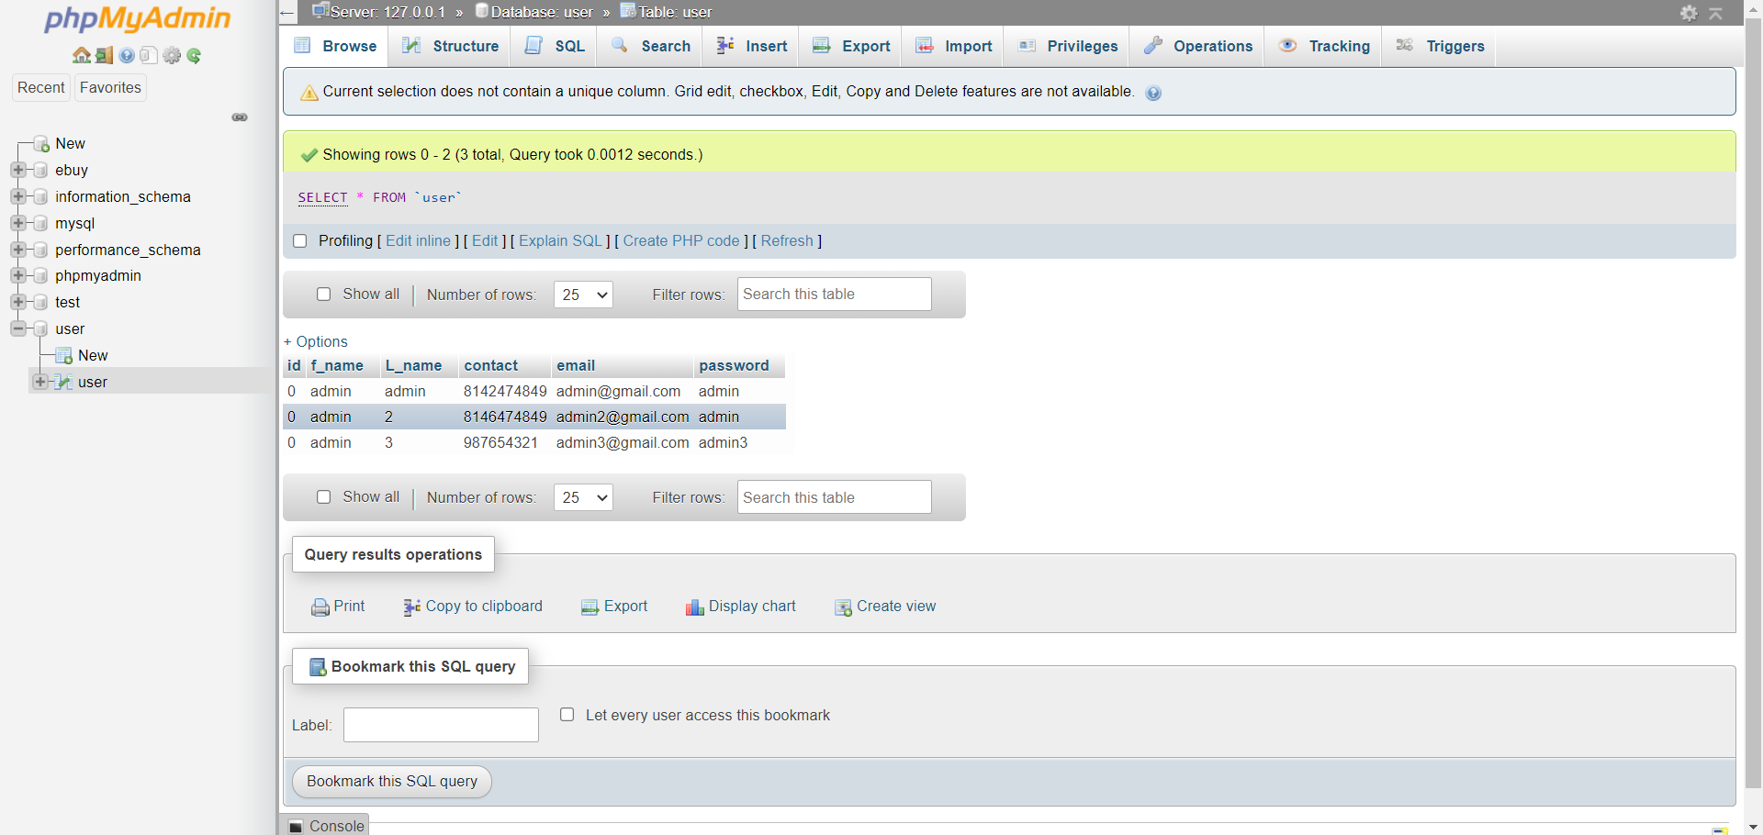
MATRUSRI
ENGINEERING COLLEGE
OUTPUT SCREEN

Slide 33
MATRUSRI
ENGINEERING COLLEGE
CONCLUSION AND FUTURE ENHANCEMENT
With this system, the products journey from manufacturing to customer can be recorded, and the customer is assured that the scans are not faked. Manufacture is able to prove their product is authentic and is also able to track their products pathway. The setup is easy to implement and requires less operation cost. Manufacturer can also adopt RFID or NFC tokens instead of QR codes to further strengthen their system.
We would like to implement this project in real time scenario using mobile application. This project as of now is a prototype but in the future Enhancement we would like to deploy it in the public blockchain with Realtime data handling. We would also like to add functionalities related to both user and manufacturer by increasing security and options and making it user friendly.

Slide 34
MATRUSRI
ENGINEERING COLLEGE
REFERENCES
[1]http://www.iadisportal.org/digital-library/improving-fake-product-detection-usingai-based-technology
[2] Tran, Thinh & Hong, Sung. (2015). RFID Anti-Counterfeiting for Retailing Systems. Journal of Applied Mathematics and Physics. 03. 1-9. 10.4236/jamp.2015.31001.
[3] Chow, Yang-Wai & Susilo, Willy & Tonien, Joseph & Zong, Wei. (2017). A QR Code Watermarking Approach Based on the DWT-DCT Technique. 314-331. 10.1007/978-3-319-59870-3_18.
[4] G. Wood, ‗‗Ethereum: A secure decentralised generalized transaction ledger,‘‘ Tech. Rep., 2014. [4] http://www.ijstr.org/final-print/dec2019/A-Survey-Of-Counterfeit-Product Detection.pdf
[5] Chen, Si & Shi, Rui & Ren, Zhuangyu & Yan, Jiaqi & Shi, Amy & Zhang, Jinyu. (2017). A Blockchain-Based Supply Chain Quality Management Framework. 10.1109/ICEBE.2017.34.
[6] https://pypi.org/project/qrcode/
[7] https://pypi.org/project/opencv-python/
[8] Ma, Jinhua & Lin, Shih-Ya & Chen, Xin & Sun, Hung-Min & Chen, Yeh-Cheng & Wang, Huaxiong. (2020). A Blockchain-Based Application System for Product AntiCounterfeiting. IEEE Access. PP. 1-1. 10.1109/ACCESS.2020.2972026

Slide 35
MATRUSRI
ENGINEERING COLLEGE
ANY QUERIES ?

